Slide 1
SkillsUSA Louisiana NLSC 2023 Meeting
June 19-23, 2023

Slide 2

NLSC 2023 Call to Conference Video
Notes:
NLSC 2023 Call to Conference Video will be available on March 1

Slide 3
SkillsUSA Louisiana NLSC 2023 Meeting
June 19-23, 2023

Slide 4
Condensed Agenda
Monday, June 19
Travel Day
State Delegation Meeting
Tuesday, June 20
SkillsUSA Championships
SkillsUSA TECHSPO
Academy of Excellence
SkillsUSA University
Opening Session
Wednesday, June 21
SkillsUSA Championships
SkillsUSA TECHSPO
Academy of Excellence
SkillsUSA University
Thursday, June 22
SkillsUSA Championships
SkillsUSA TECHSPO
Academy of Excellence
SkillsUSA University
Champions Festival
Friday, June 23
Community Service Project
Awards Session
Saturday, June 24
Travel Day

Slide 5


Pre-Conference Sat., June 17 - Mon., June 19
Activate (Chapter Leaders)
Activate is a two-and-a-half-day, high-energy leadership conference that is open to all middle school and high school SkillsUSA student leaders.
Engage (Advisors/Educators)
Engage is a professional development conference that assists teachers and SkillsUSA advisors in elevating their teaching skills to new levels.

Slide 6
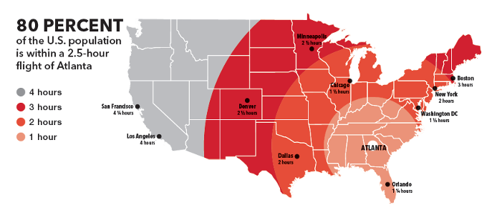
Travel Information
Recommended travel is by air to Hartsfield-Jackson Atlanta International Airport. Book flights with arrival times before 6 p.m.
Use DART Transportation or MARTA to quickly get to our conference hotel.

Slide 7


Slide 8

Hotel Information
Hilton Atlanta

Slide 9


Slide 10

SkillsUSA Championships Information
Career competition updates will be posted to the
SkillsUSA website at
SkillsUSA.org/updates
Review the SkillsUSA Championships Technical Standards available in SkillsUSA Absorb LMS to professional members.

Slide 11

SkillsUSA Advisor Summit
Advisors attend NLSC to focus on your individual professional development.
Enjoy a customized experience
Exclusive pre and post sessions
Guided tour of the conference floor
Educational resources

Slide 12
Louisiana Registration Information
Registration must take place on the SkillsUSA Online Registration Site.
Registration:
  Open - April 1
  Close – May 12 6:00PM
  Payment Due (Received at State Office) – May 26

Slide 13
SEE YOU IN ATLANTA!
Questions?
Contact State Director Jeremy Boudreaux

