Slide 1
SkillsUSA Louisiana NLSC 2024 Meeting
June 24-28, 2024

Slide 2
NLSC 2024: Call to Conference Video
Notes:
NLSC 2023 Call to Conference Video will be available on March 1

Slide 3
SkillsUSA Louisiana NLSC 2024 Meeting
June 24-28, 2024

Slide 4
Condensed Agenda
Monday, June 24
Travel Day
State Delegation Meeting
Tuesday, June 25
SkillsUSA Championships
SkillsUSA TECHSPO
Academy of Excellence
SkillsUSA University
Opening Session
Wednesday, June 26
SkillsUSA Championships
SkillsUSA TECHSPO
Academy of Excellence
SkillsUSA University
Thursday, June 27
SkillsUSA Championships
SkillsUSA TECHSPO
Academy of Excellence
SkillsUSA University
Champions Festival
Friday, June 28
Community Service Project
Awards Session
Saturday, June 29
Travel Day

Slide 5
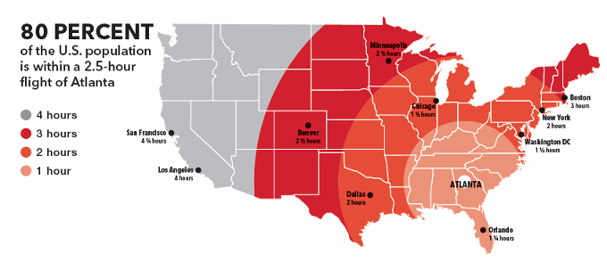
Travel Information
Recommended travel is by air to Hartsfield-Jackson Atlanta International Airport. Book flights with arrival times before X p.m.
Use DART Transportation or MARTA to quickly get to our conference hotel.

Slide 6
Hotel Information
State Hotel
Westin Peachtree Plaza
Rate is
$194 Night
Use of the PassKey system to book hotel

Slide 7
SkillsUSA Championships Information
Career competition updates will be posted to the SkillsUSA website at
SkillsUSA.org/competitions
Review the SkillsUSA Championships Technical Standards available in SkillsUSA Absorb LMS to professional members.

Slide 8
SkillsUSA Advisor Summit
Advisors attend NLSC to focus on your individual professional development.
Enjoy a customized experience
Exclusive pre and post sessions
Guided tour of the conference floor
Educational resources

Slide 9
Louisiana Registration Information
Registration Is Currently Open
Deadline – May 10
Payment to State Office before May 14

Slide 10
SEE YOU IN ATLANTA!
Questions?

